Slide 1

Gamma Class – Group 2 1. Abu Ibrahim Ezebre 2. Jedidah Wawira Kariuki 3. Lerato Valentina Majalle 4. Maryam Ologbonsaye 5. Gilbert Amoah

Slide 2
Capstone Project Title: Salary Prediction

Slide 3
OUTLINE
Project Brief
Project Roadmap
Data Summary
Salary Distribution
Model Comparison Report
Feature Importance Distribution
Recommendations
Summary

Slide 4
Project Brief
Aim
The primary goal of this project is to develop a predictive model that estimates an individual’s salary based on their demographic and professional attributes.
Key Outcomes
Develop a salary prediction model.
Leverage regression analysis and machine learning techniques for feature impact analysis.
Provide recommendations based on our findings.

Slide 5
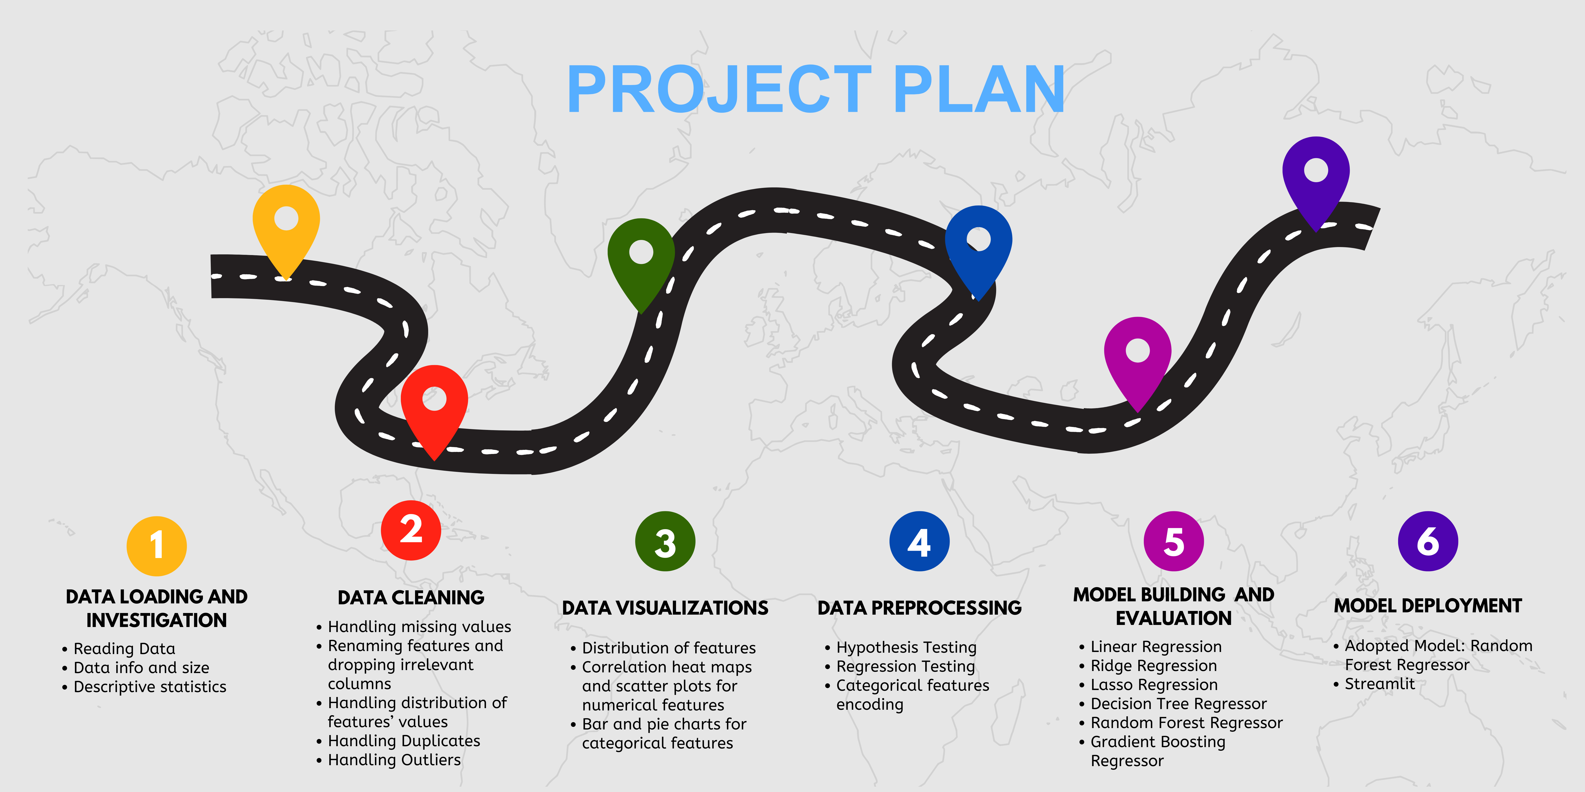
selecting visual aids

Slide 6
Data Summary
Total Count: 6698
Gender | Male | Female | Other
Count | 3671 | 3013 | 14
Education Level | Bachelor Degree | Master Degree | PhD | High School
Count | 3021 | 1860 | 1369 | 448
Country | USA | China | Australia | UK | Canada
Count | 1359 | 1343 | 1336 | 1335 | 1325
Race | White | Asian | Korean | Australian | Chinese | Black | African American | Mixed | Welsh | Hispanic
Count | 1962 | 1603 | 457 | 452 | 444 | 437 | 354 | 334 | 333 | 322

Slide 7
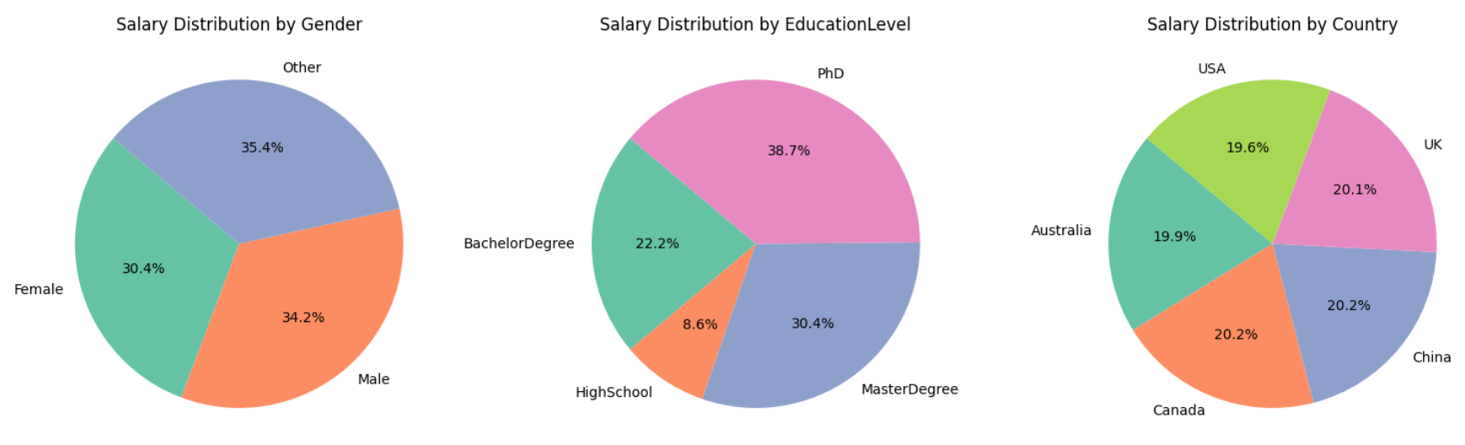
SALARY DISTRIBUTION
ENHANCING YOUR PRESENTATION

Slide 8
Model Comparison Report
MODEL | MEAN SQUARED ERROR | MEAN ABSOLUTE ERROR | R-SQUARED | ADJUSTED R-SQUARED
Linear Regression | 0.077967 | 0.191227 | 0.758443 | 0.757355
Ridge Regression | 0.078052 | 0.191328 | 0.758180 | 0.757091
Lasso Regression | 0.322871 | 0.465762 | -0.000318 | -0.004821
Decision Tree Regressor | 0.102018 | 0.083931 | 0.683928 | 0.682506
Random Forest Regressor | 0.050292 | 0.077558 | 0.844185 | 0.843483

Slide 9
Adopted Model
Random Forest Regressor Model
R-squared: 84.4%
Adjusted R-squared: 84.3%
MSE: 0.0503
MAE: 0.0776
Best performing model based on the evaluated metrics.

Slide 10
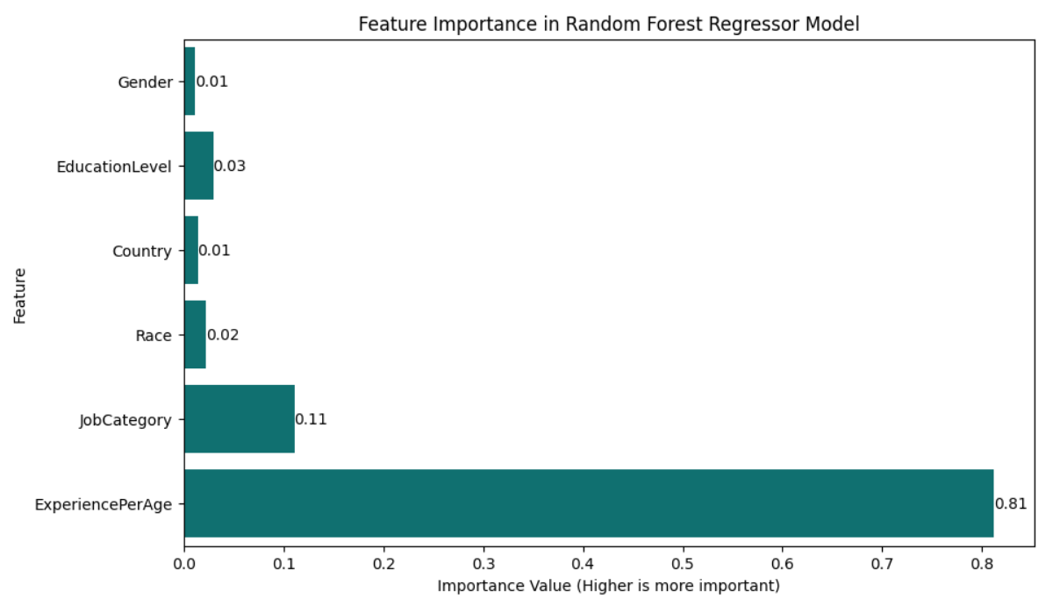
FEATURE IMPORTANCE DISTRIBUTION

Slide 11
Recommendations
Encourage & support employees to pursue higher education for better performance and compensation.
Invest in employee development programs to enhance experience.
Diversity & inclusion for factors with minimal impact as per this current analysis to foster a positive work environment.
Role-specific training and development opportunities to ensure employees can advance in their specific roles.

Slide 12

Summary
Objective: Our project developed a predictive model to
estimate salaries based on demographic and professional attributes.
Model Performance: The Random Forest Regressor was the
best-performing model with an R-squared of 84.4%, indicating strong predictive accuracy.
Key Findings:
Higher education levels are strongly associated with higher salaries.
Professional experience significantly impacts salary predictions.
Factors like race and gender showed varied impact on salary but are essential for fostering a positive workplace environment.
Recommendations
Education Support, Employee Development, Inclusive Policies
Business Impact: Implementing these findings can lead to better talent management, fairer compensation strategies, and improved workforce satisfaction.

Slide 13
Thank you

